Slide 1
FANTASTIC
5
F
5
“Refreshingly Innovative…”

Slide 2

Members
Christopher Mahon: Team Leader
Christopher Jerrard-Dunne: Coder/Designer
Konrad Jedrol: Planner
Jun Hee Jang: Tester
Jake Mulholland: Documenter

Slide 3
Summary
The project is Tanks, the remake of the arcade game Battlezone
As well as remake Battlezone, we are also required to implement Kinect support

Slide 4
Assumptions & Dependencies
Portability
Easily configurable
Multiple control schemes
Freedom

Slide 5
Development Methods
Agile Software Development (SCRUM)
One week development cycles
Meeting gamesfleadh

Slide 6
High Level System Architecture
Unity3D Integration
MS Kinect SDK
“Vectrosity” Graphics Plug-in

Slide 7
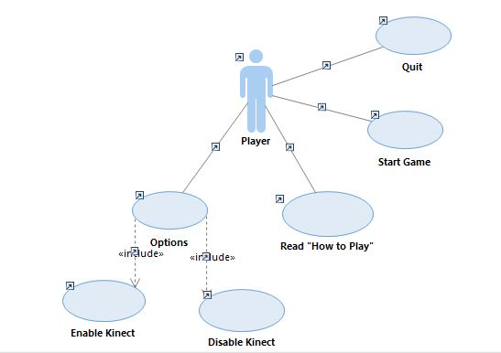
Menu Use Case

Slide 8
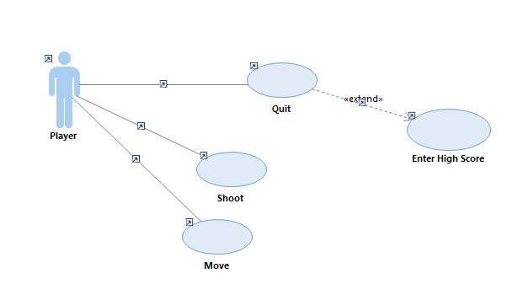
In-Game Use Case

Slide 9
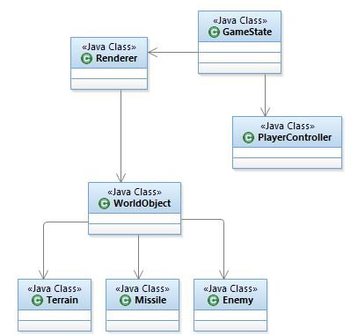
Class Diagram

Slide 10
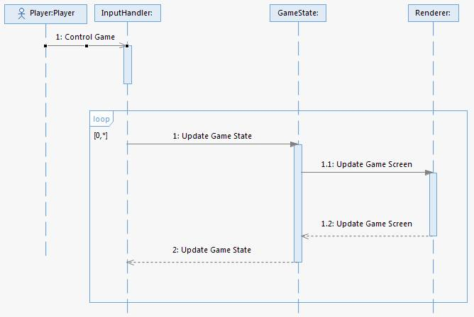
Game Loop Sequence

Slide 11
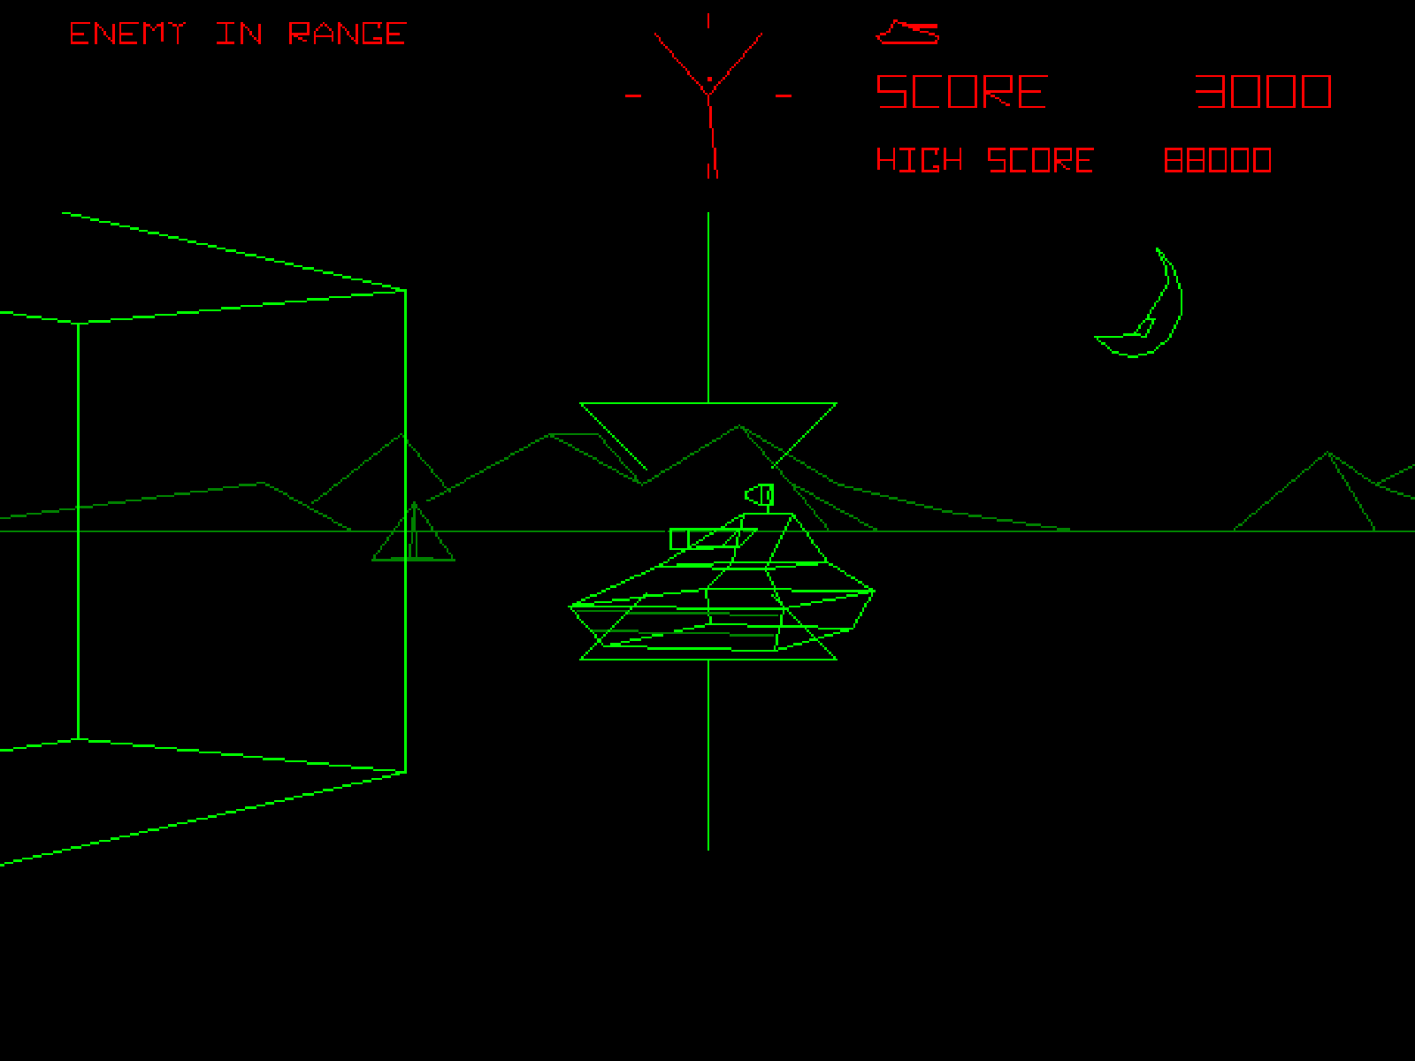
User Interface

